Slide 1
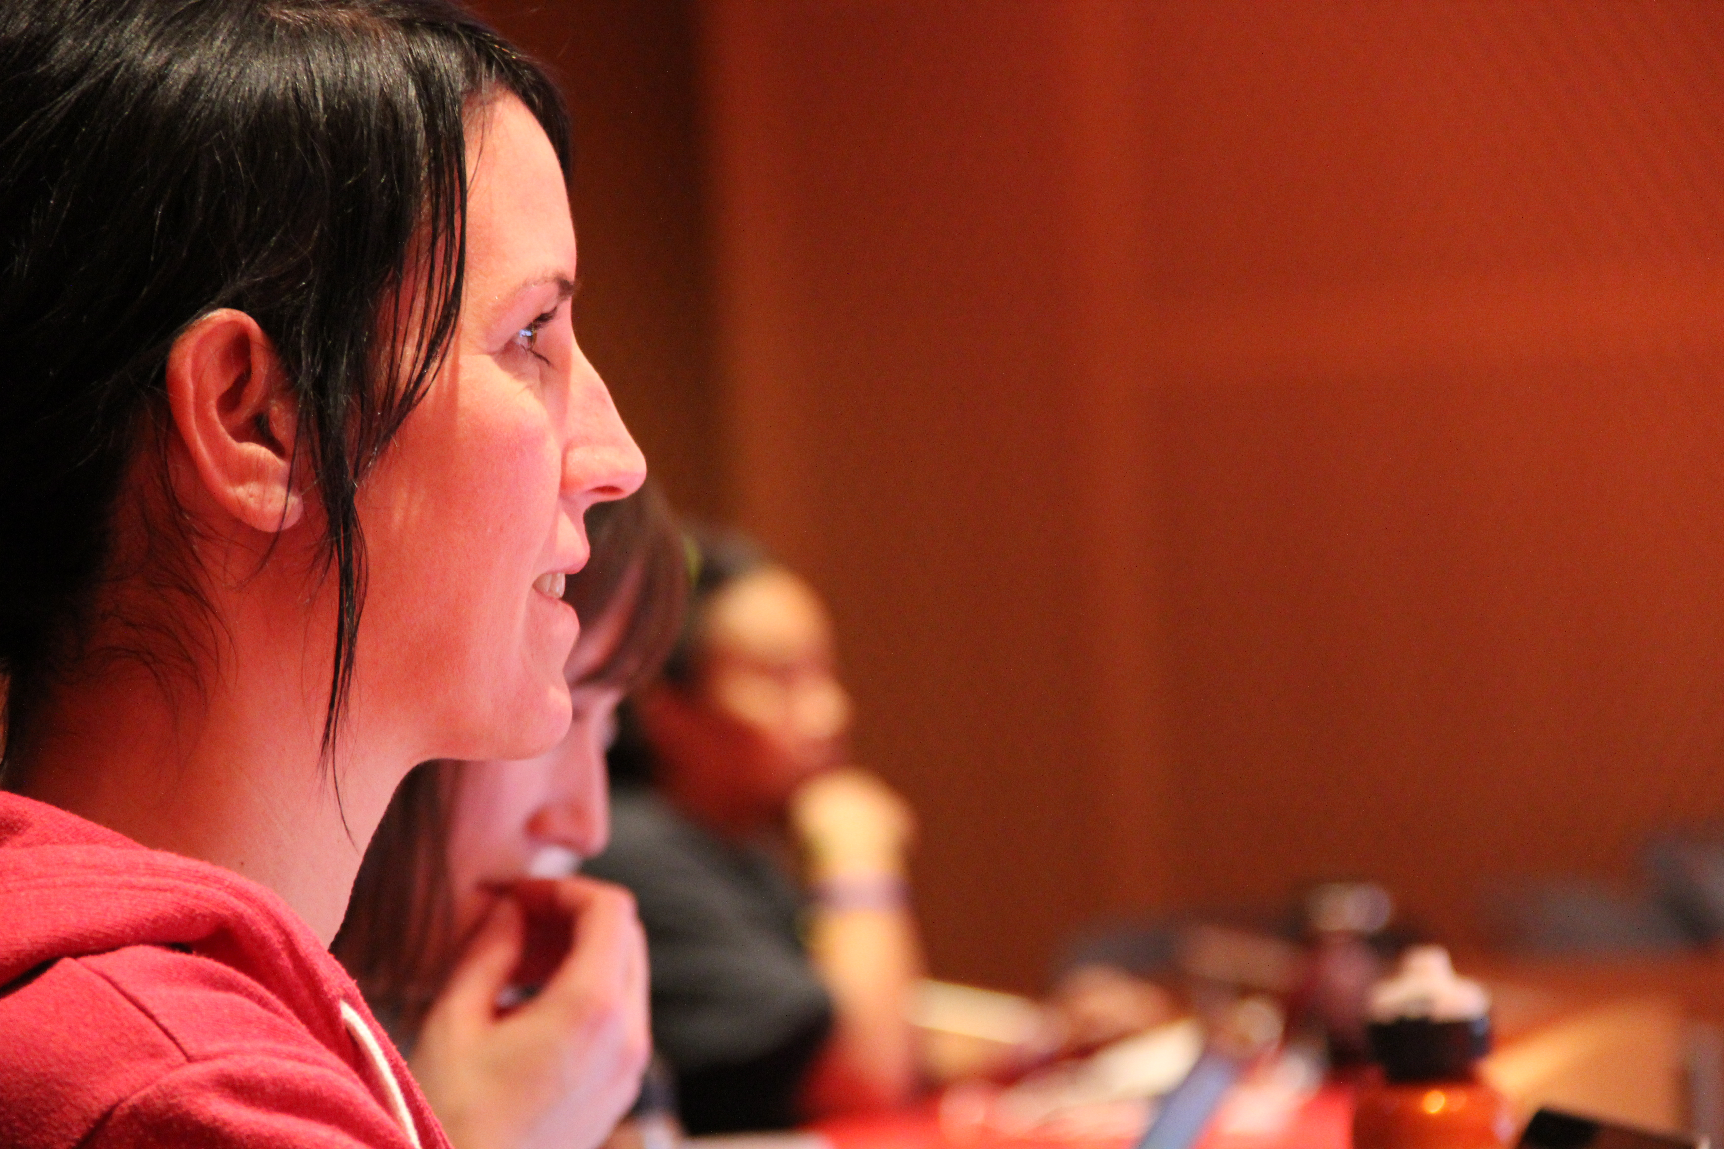
Boston
Python Workshop
structure

Slide 2
Friday:
setup, practice
Saturday:
lecture, lunch,
practice, projects

Slide 3
Friday:
setup, practice
Saturday:
lecture, lunch,
practice, projects

Slide 4
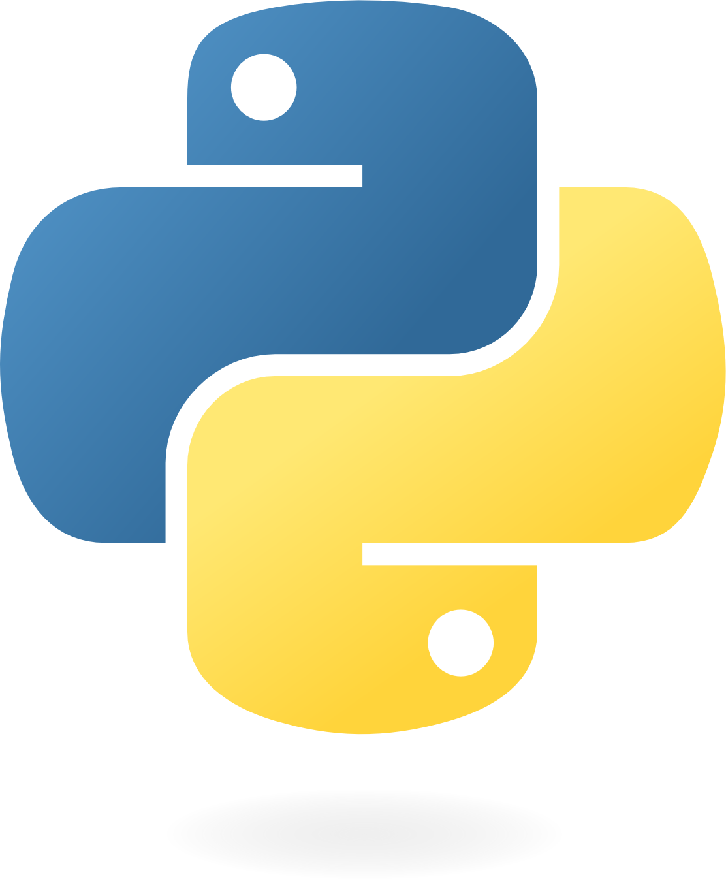


Friday: setup
Saturday:
lecture
lunch
projects
python setup.py install
>>> 4+3

Slide 5
Friday: setup
Saturday:
lecture
lunch
projects
python setup.py install
>>> 4+3

Slide 6
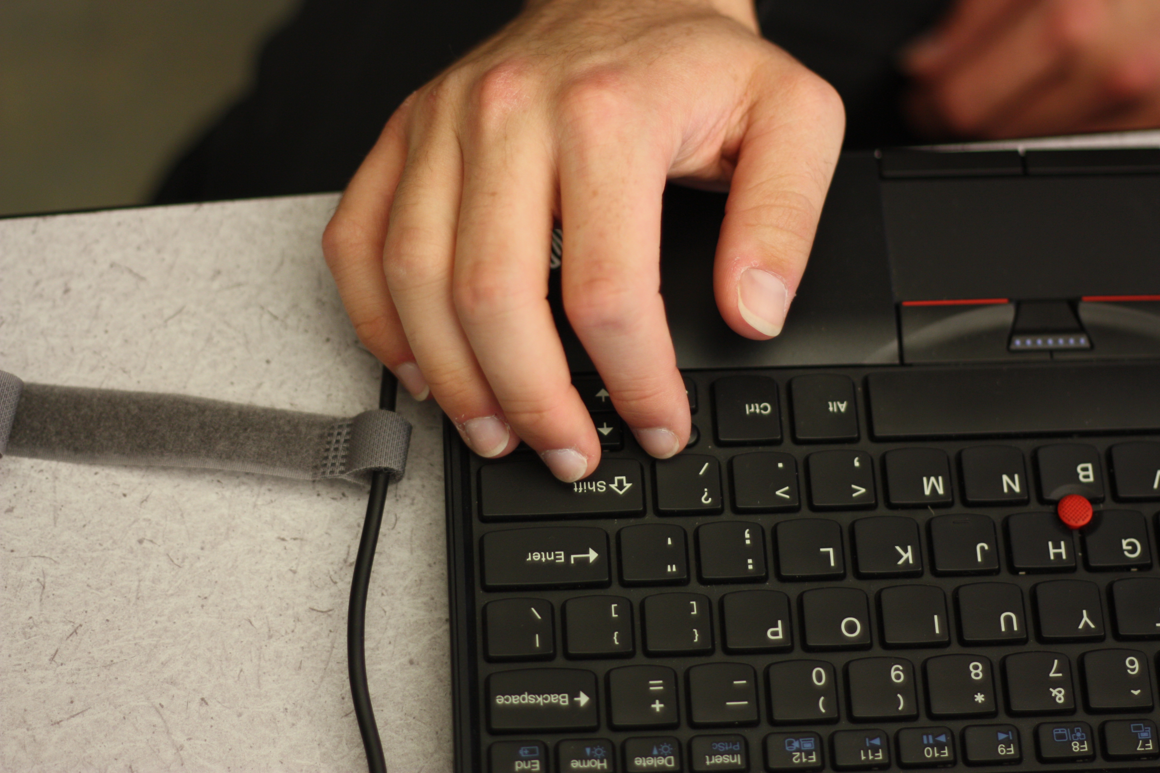
Friday: practice

Slide 7
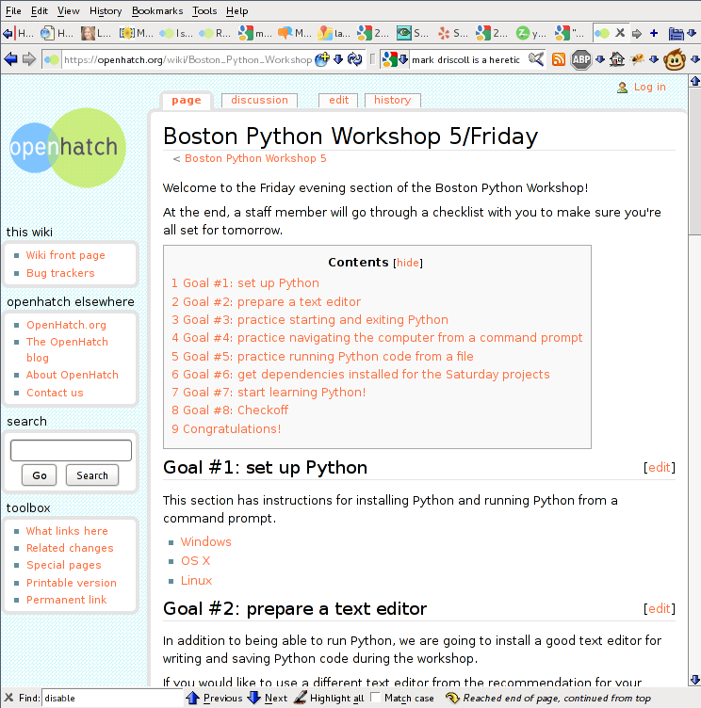
(organized, editable, online)

Slide 8
Friday:
setup, practice
Saturday:
lecture, lunch,
practice, projects

Slide 9
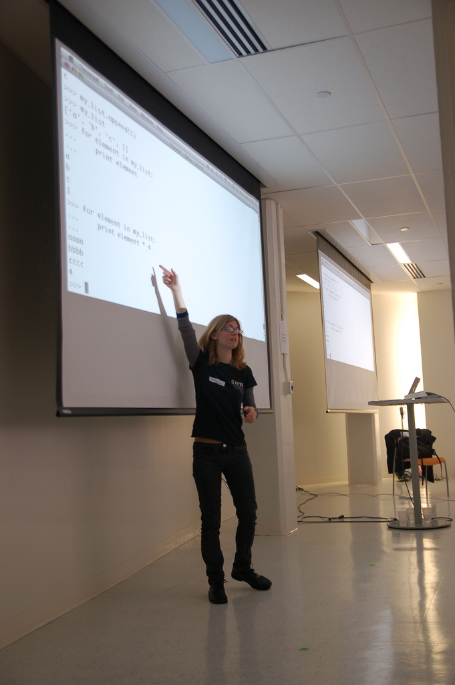
Sat
lecture

Slide 10
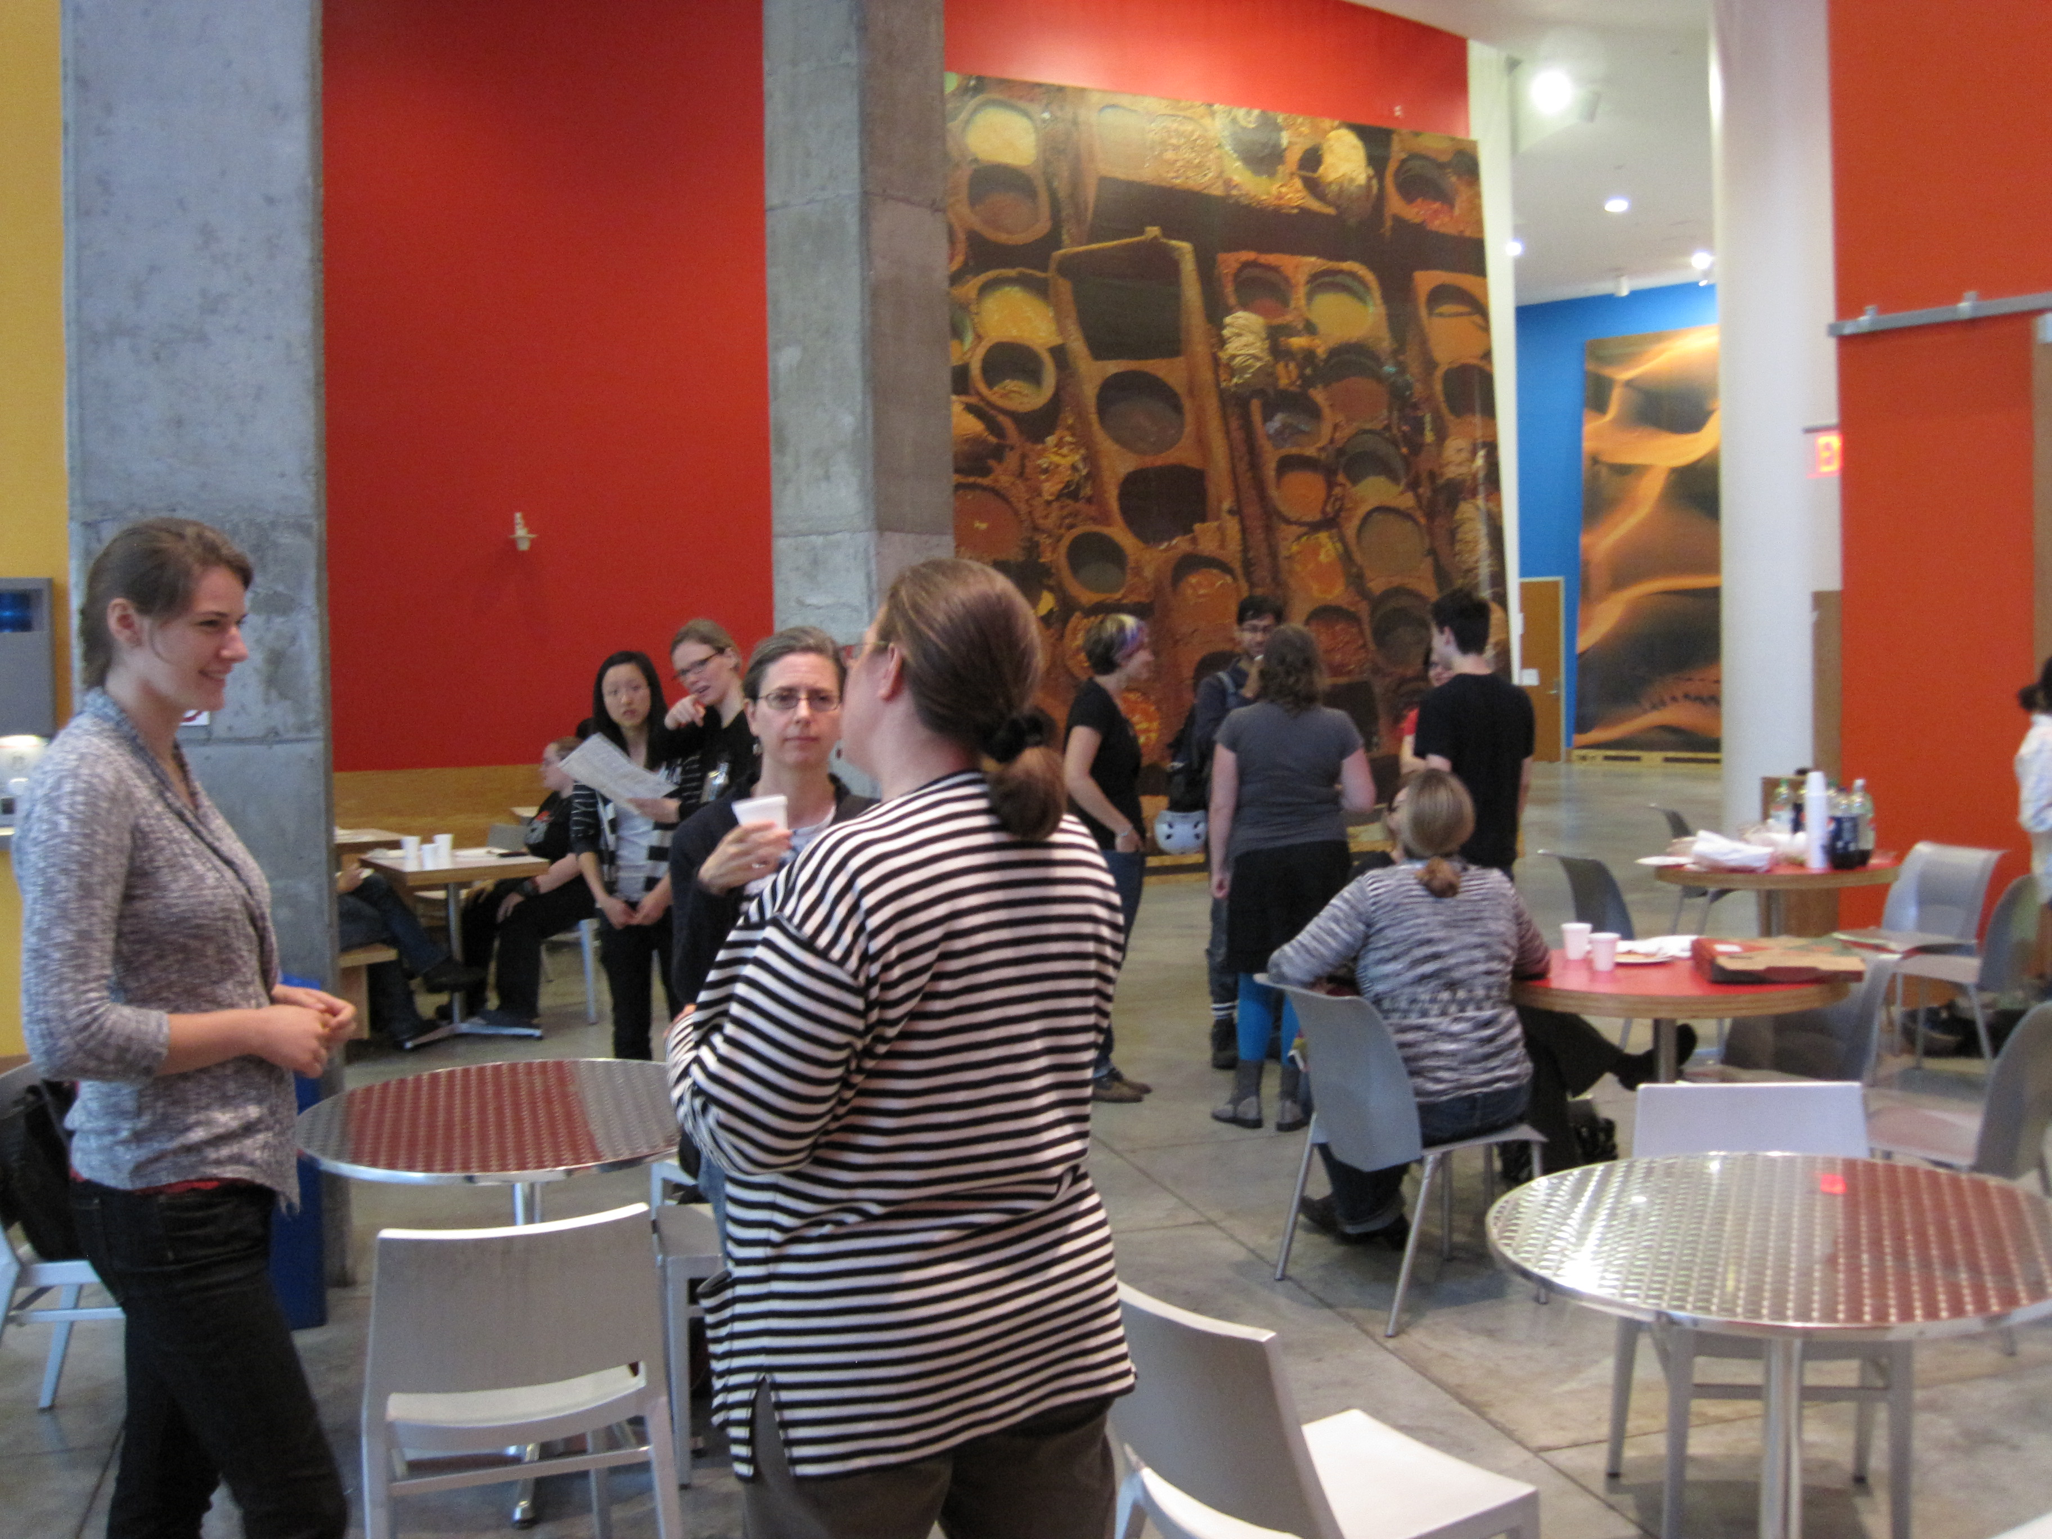
Sat
lunch

Slide 11
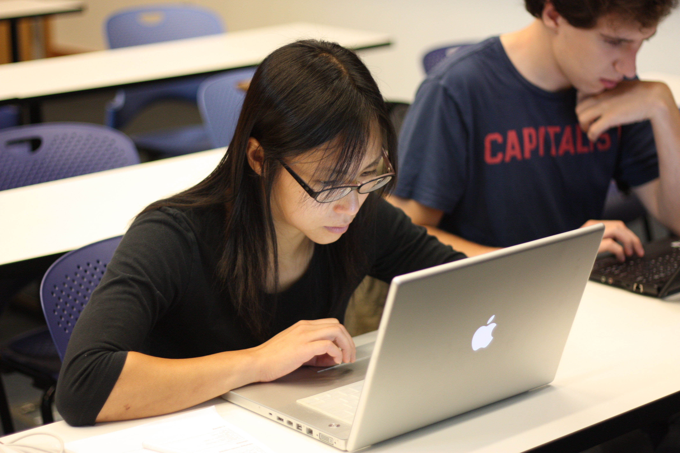
Sat practice
Saturday

Slide 12
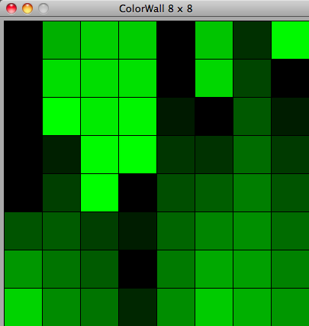

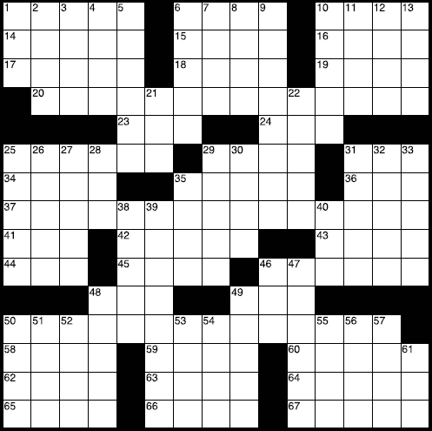
Saturday projects
Saturday

Slide 13
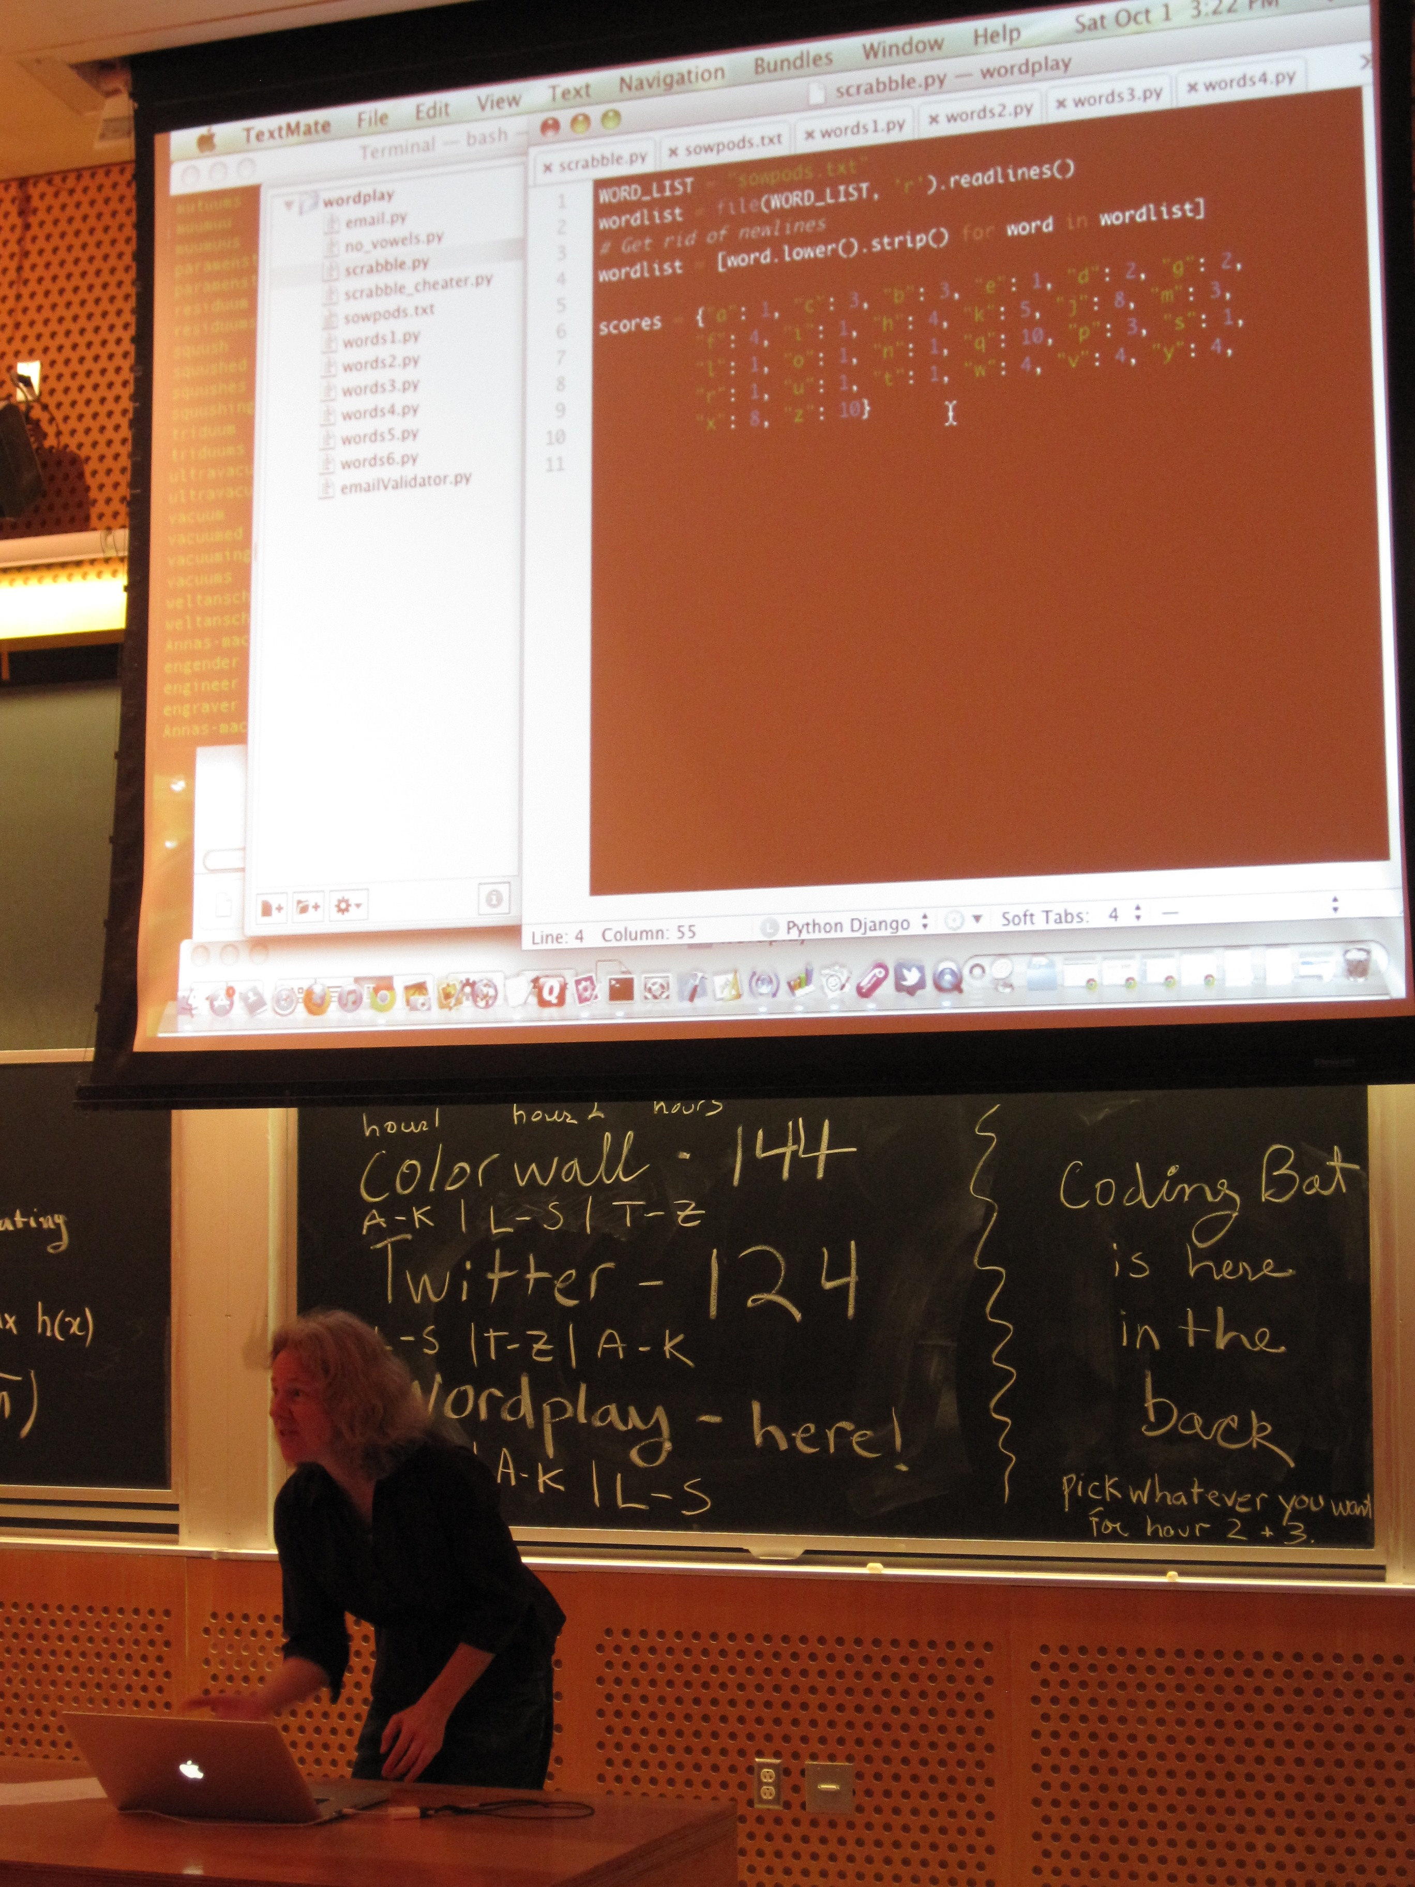
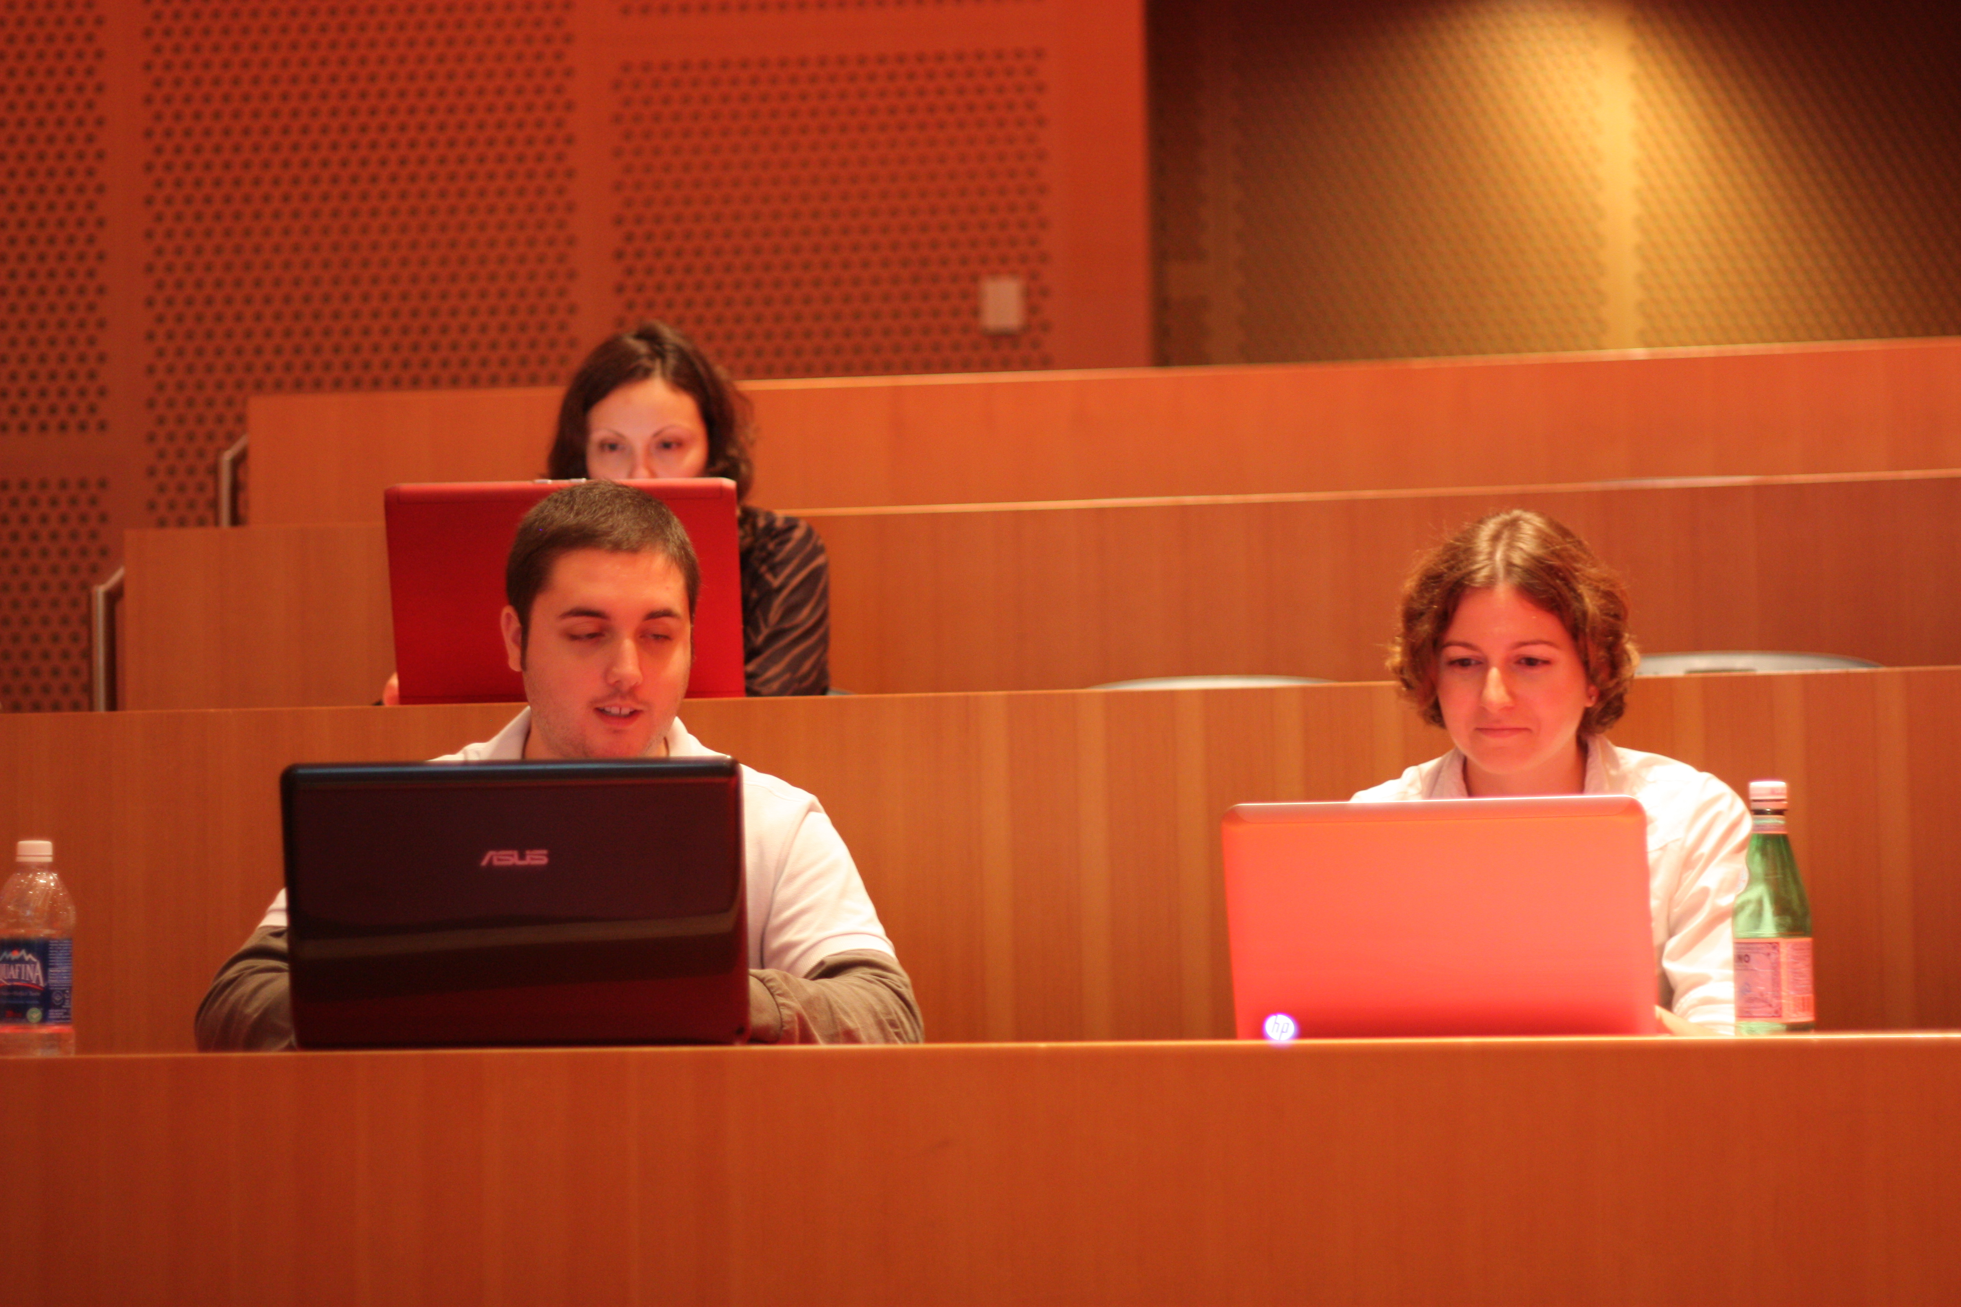
Projects: part lecture, part hands-on

Slide 14
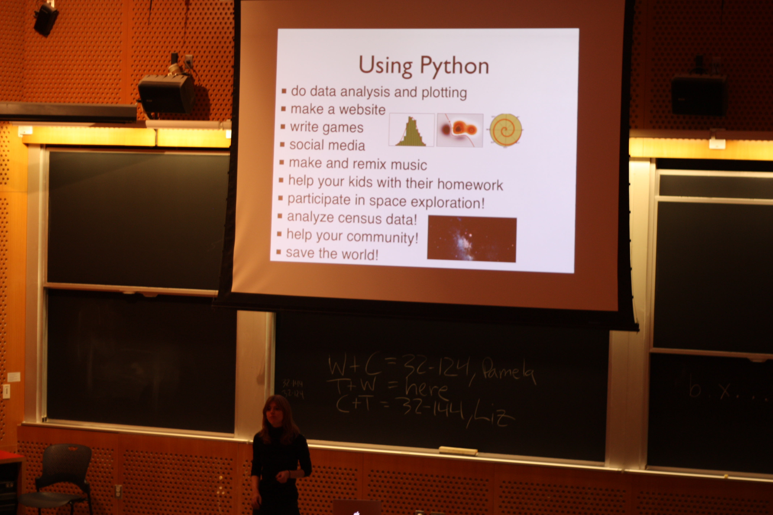
Sat wrap-up

Slide 15
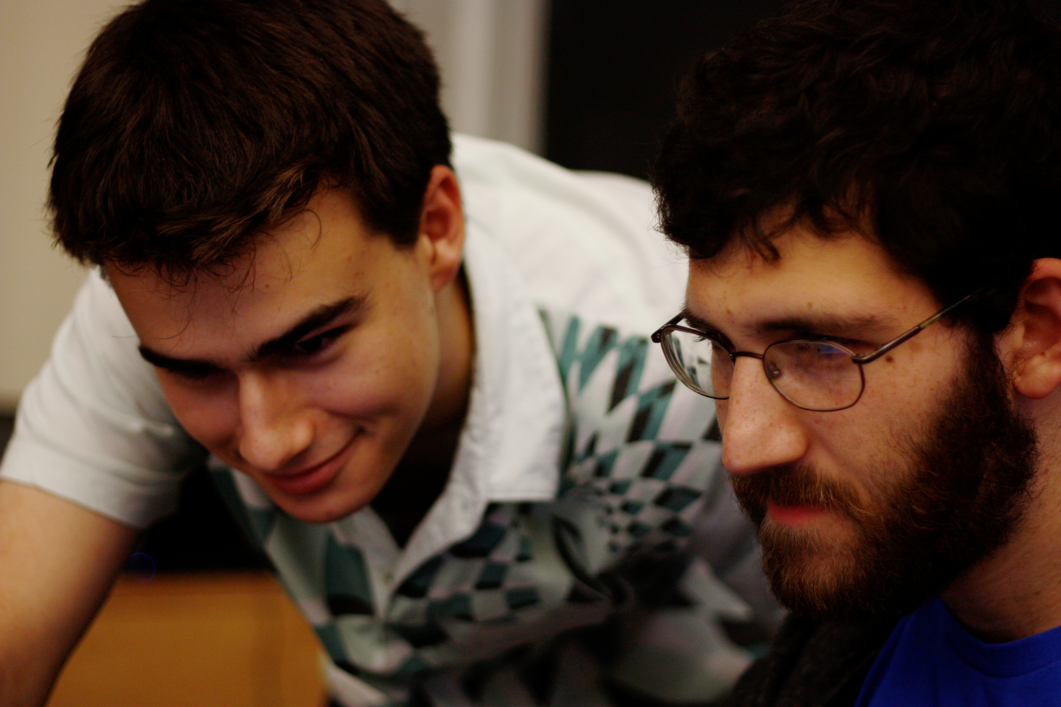
Reflection
&
sharing

Slide 16
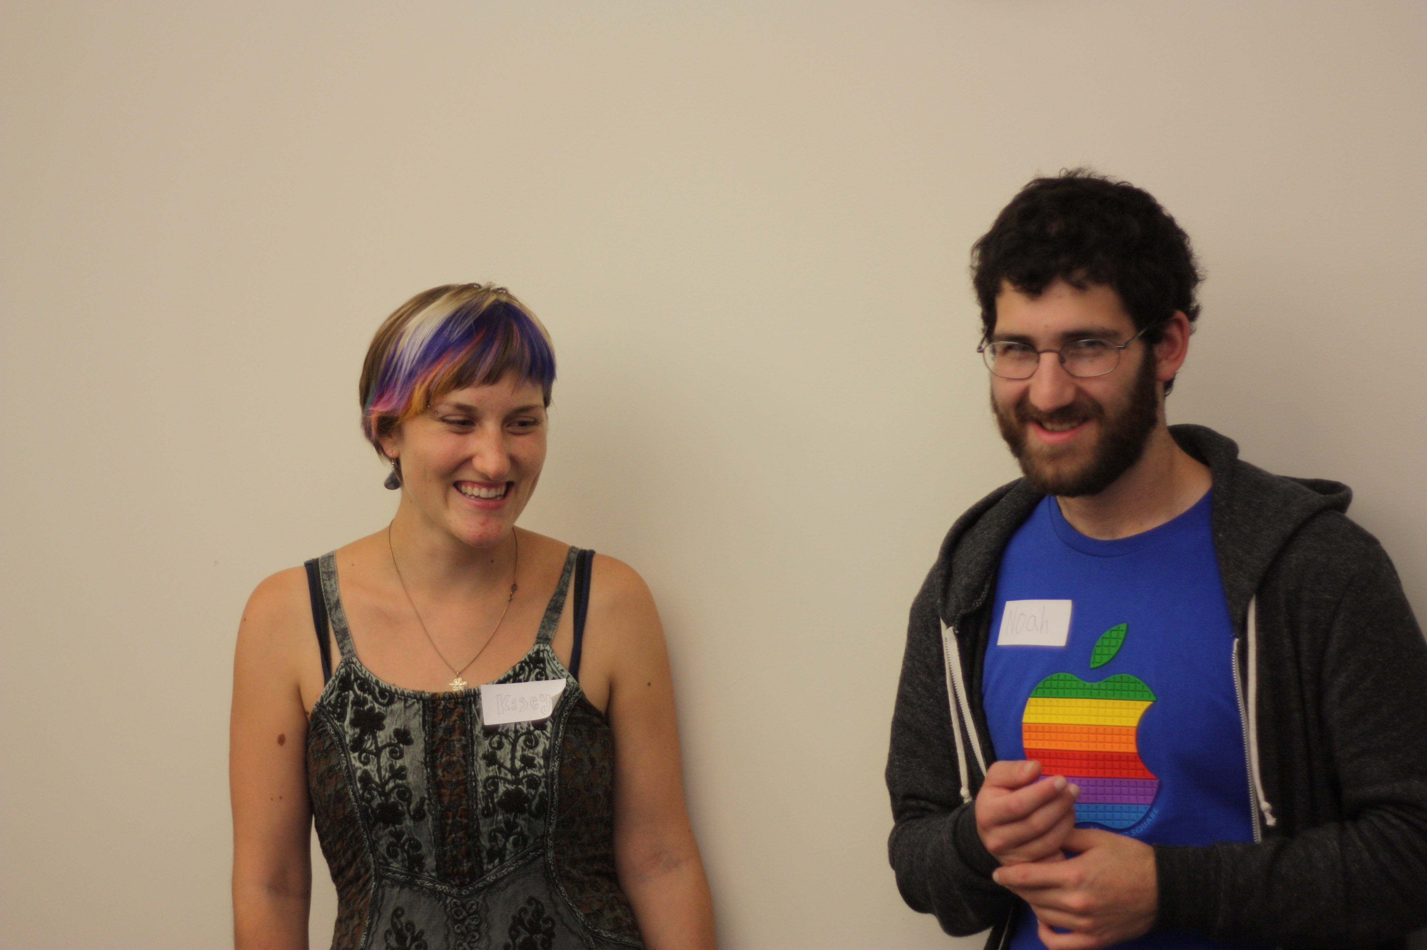
volunteers

Slide 17
Why'd you sign up?
Prior experience
Will you continue?
Feedback
“women,
judgment-free,
free”

Slide 18
Why'd you sign up?
Prior experience
Will you continue?
Feedback
“feeling welcome in what felt like a closed world to me”

Slide 19
Staff wrap-up

Slide 20
more coding practice
fewer projects

Slide 21
How we share
curriculum on wiki
events mailing list
OpenHatch blog

Slide 22
How we share
curriculum on wiki
events mailing list
OpenHatch blog

Slide 23
How we share
curriculum on wiki
events mailing list
OpenHatch blog

Slide 24
How we share
curriculum on wiki
events mailing list
OpenHatch blog

Slide 25
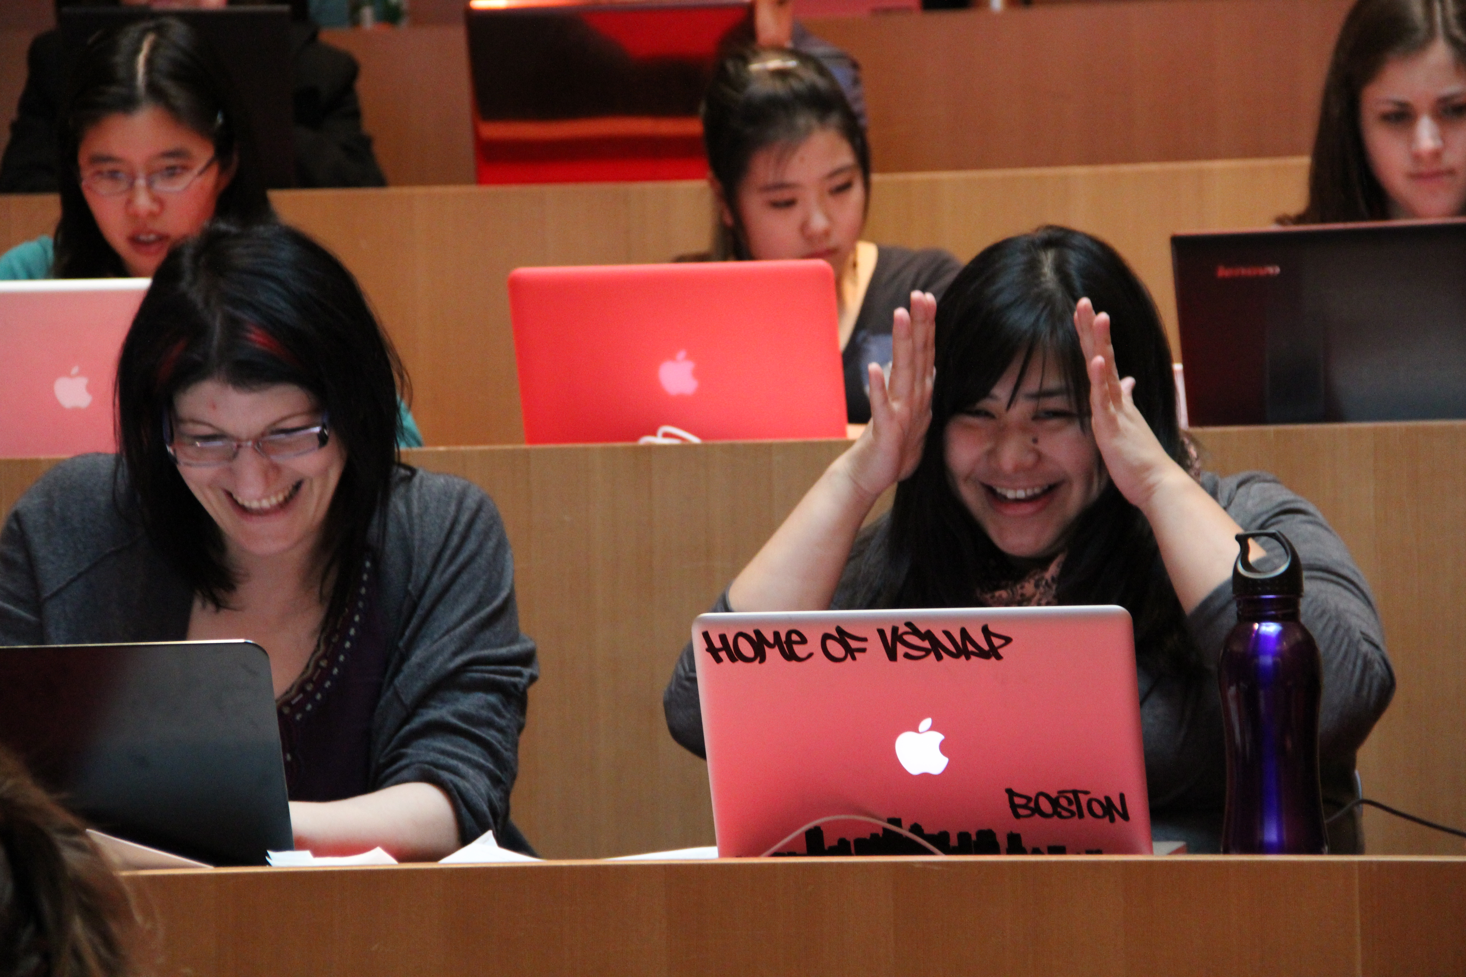
Scaling out:
impact beyond Boston

Slide 26


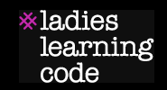
More efforts
Montreal Python

Slide 27
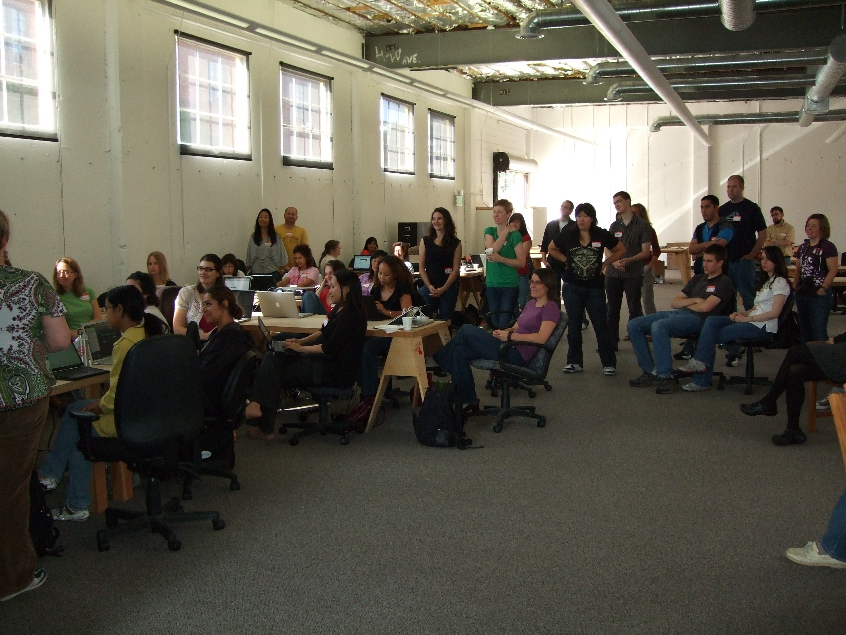
from sf.ruby import railsbridge

Slide 28
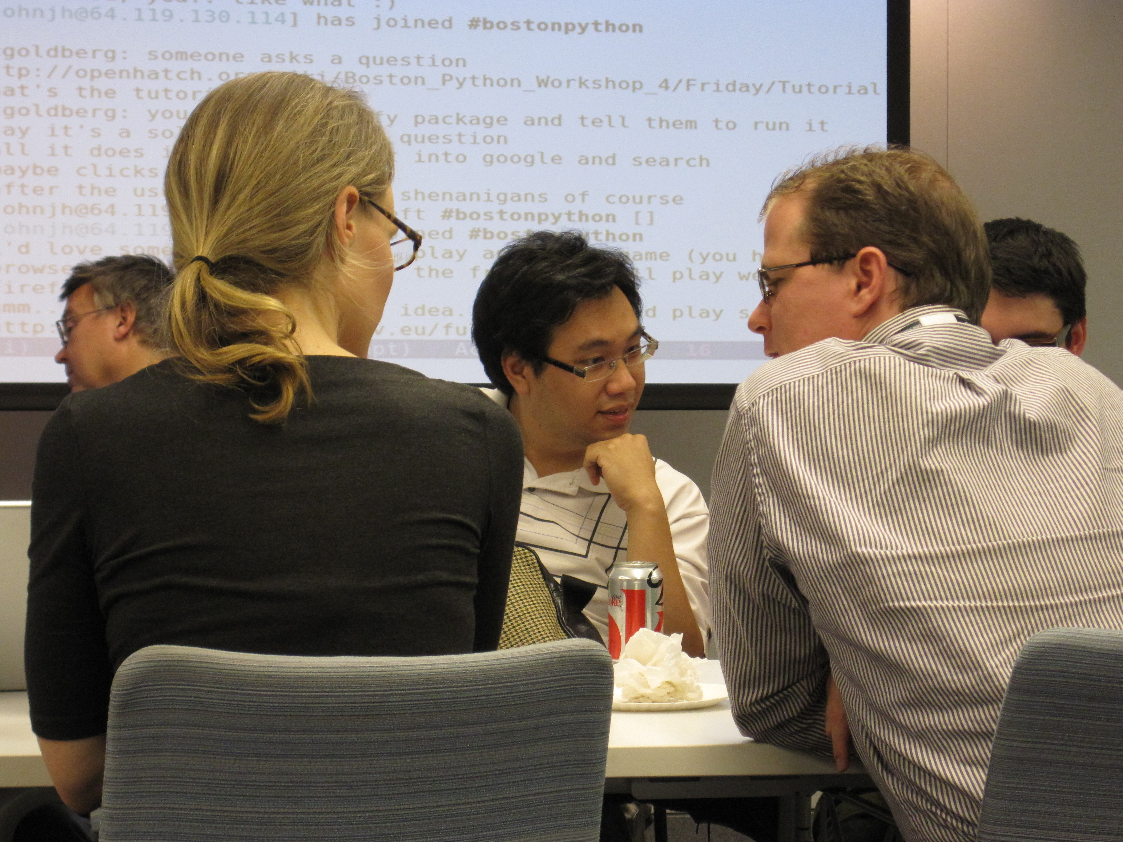
part of the user group

Slide 29
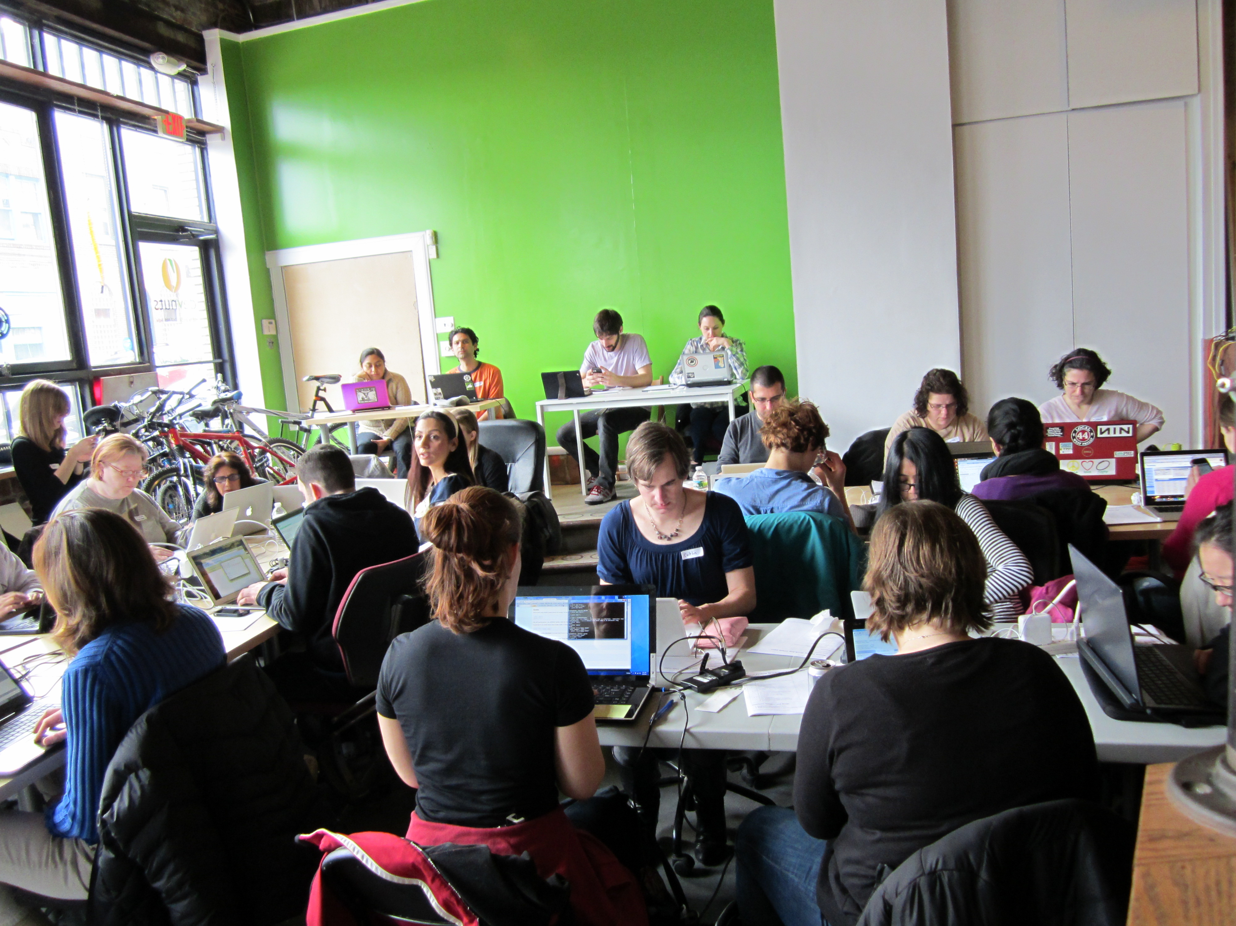
PyStar Philly
+ PhillyPUG

Slide 30
Minneapolis PyStar
+ PyMNtos

Slide 31


Slide 32

Outreach in your city
Say hello: hello@openhatch.org
Find us during the sprints
1. Run a project night
2. Run an intro event
3. Iterate + discuss

Slide 33
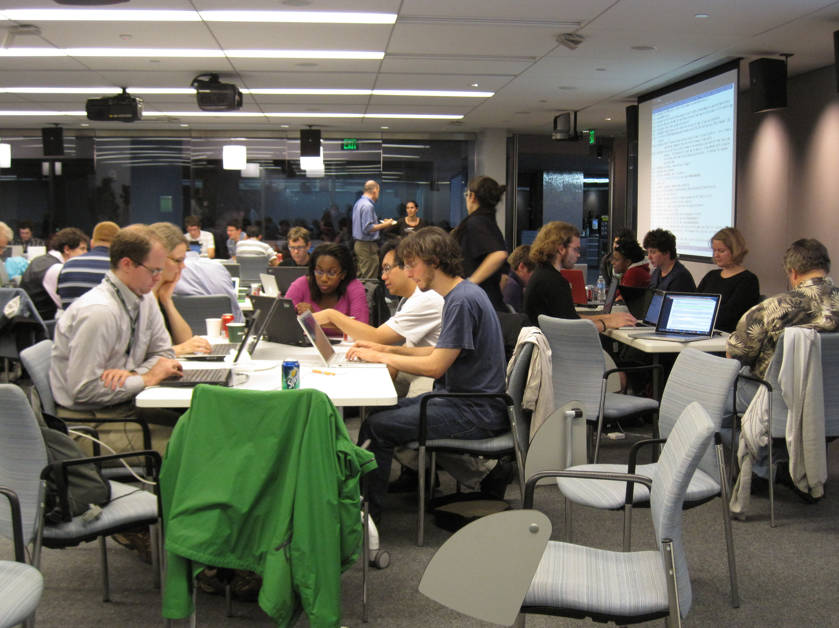
easy to organize! beginners' corner set the tone
run a project
night

Slide 34
Run an intro event
It's okay to start conservatively
  Pick a goal and stick to it
Use the existing user group base to your advantage
Ask for help!

